Slide 1

Notes:
Respected Professors and my peers,
I wish to present to you, The Eye. A new club under the Computer Science and Engineering Association with a focus on Cyber Security. Our goals include high-level tasks like spreading awareness as well as low-level in-depth tasks like developing Security Intelligence Software and Tools.
Our tagline is “Visio Protectoris” – which means “The Vision of the Protectors” in Latin.

Slide 2

Notes:
I will be taking a few minutes of your time to present to you the goals of our newly founded club, as well as introduce the office bearers of the newly founded club.

Slide 3
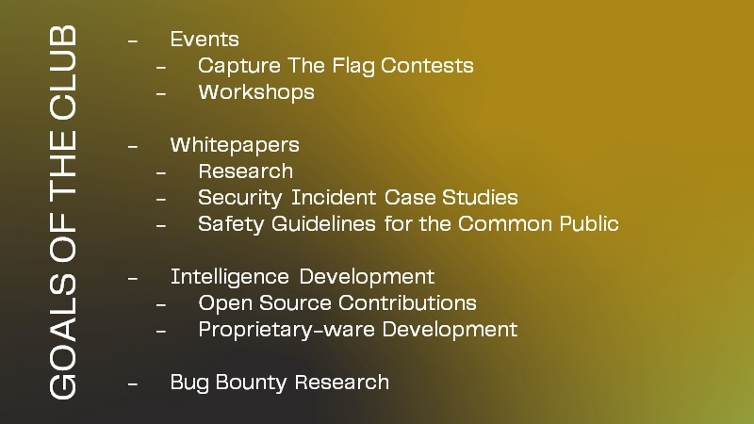
Notes:
The goals of the club are four.
Events – We plan to conduct 2-3 events for the academic year of 2022-2023, which can be of 2 types. Capture The Flag Contests, which are essentially hackathons, featuring attractive rewards and prizes, and Workshops in order to spread awareness on Cybersecurity and inculcate the Cybersecurity culture in our college.
Whitepapers – We plan to release on our website whitepapers of 3 types – Research Papers on new fields in Cybersecurity, Case Studies on Security Incidents like the recent Uber Hack where Uber was hacked by an employee of it’s own, and Safety Guideline documents for the common public involving topics like Guidelines on using Email Safely, Guidelines on staying safe from Phishing, etc.
Intelligence Development – This involves developing tools and programs to assist in Security Research Operations to help secure infrastructure.
Bug Bounty Research – This involves performing Security Research Operations on entities that provide Responsible Vulnerability Disclosure programmes in order to help secure infrastructure.

Slide 4

Notes:
Now, I wish to present to you the 9 office bearers of our newly founded club.

Slide 5
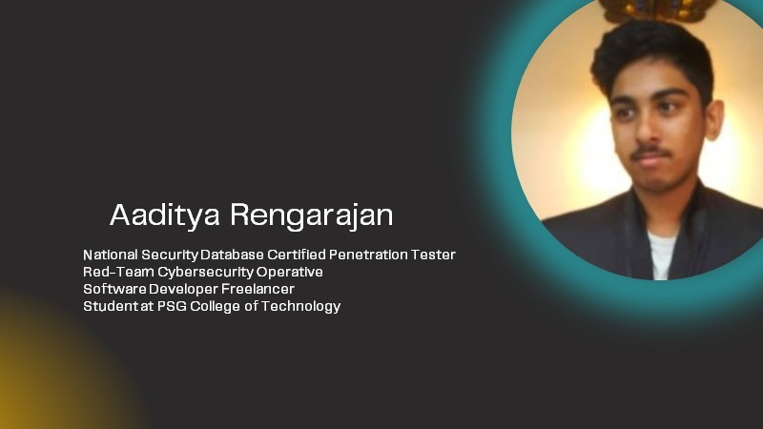
Notes:
Let us start with myself, the founding member of this club. I am Aaditya Rengarajan, am a student of BE CSE G1 of 2nd Year. I work with the National Security Database, which is endorsed by the Government of India, in order to secure the national cyber-assets, and have also received recognition from the Government of India and the Government of Kuwait for carrying out ethical hacking operations. I also work with Tactical Cyberange Simulations and ISAC (Information Sharing and Analysis Center), developing mission-critical security testing software. I am currently undergoing the Certified Ethical Hacker course by EC Council, and will be completing it by the end of this year.

Slide 6
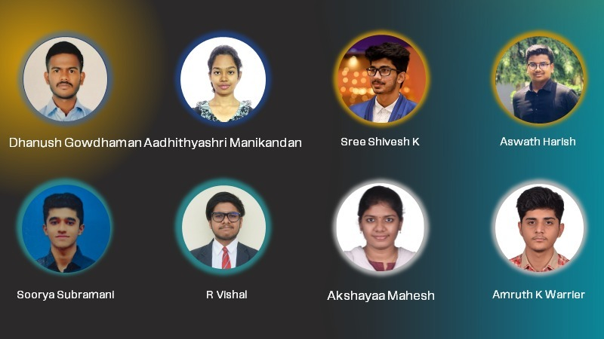
Notes:
Dhanush Gowdhaman from third year BE CSE G1. He is a great visionary with keen interest in Linux Operating Systems and Servers, and has participated in a few Capture The Flag events which has a lot of elements of cybersecurity and vulnerability testing. He also has hosted a Capture The Flag hackathon in the previous academic semester, and will assist to host events under our club this year.
Aadhithyashri Manikandan of 3rd year CSE G1. She is interested in quite a handful of fields and a couple amongst those are cybersecurity and cryptography. She had started her research in cybersecurity as a part of her exploration in the subject of computer science only to find herself engrossed in the concepts of cybersecurity. She has coded a few encryption/decryption techniques in the past, and has participated in multiple events, and will assist to host events under our club this year.
Sree Shivesh K from 3rd year CSE G2. He is an ambitious and hardworking individual who is adept at handling multiple tasks competently and at working well under pressure. He has a keen interest in Network Security concepts and will assist the club with Intelligence Development as well as organizing events under our club this year.
Aswath Harish of 3rd year BE CSE G2. He is a perseverant learner, and is a person who learns from others and also shares his learning with others. Learning never stops with him as it is his passion and he won’t stop exploring. By sharing the various skills acquired and experiences that he has encountered in a short period, he will be assisting with Intelligence Development, as well as Information Sharing and Analysis.
Soorya Subramani of second year BE CSE G1. He is notional idealist, and has participated in workshops and Capture The Flag events in the past. He is a quick learner, and an efficient contributor, and has a great amount of interest in the field of Cybersecurity. He will be assisting the club this year with document writing.
R Vishal of 2nd year CSE G1. He has a keen interest in cybersecurity and ethical hacking techniques. This was instigated by the ethical hacking workshops he attended both intra-college and external workshops conducted by different institutions. He looks forward to taking part in different hackathons and CTFs and assist to host the same under our club this year.
Akshayaa Mahesh of second year G2. Passionate about Computer Science, she is exploring different fields so as to find her domain of interest and cybersecurity is discovered to one of them. She has started her study in the field and finds a keen interest towards the concepts of Bug Bounty Research. She is a coding enthusiast, participated in events concerning cybersecurity and she will assist in document writing under our club this year.
Amruth K Warrier from BE CSE G2 2nd year. He has always been fascinated by the field of Cybersecurity, as his core interests lie in programming for Cybersecurity and AI/ML. He is an ambitious and self driven individual with a never ending thirst for knowledge, and will assist in Bug Bounty Research and Intelligence Development under our club this year.

